Slide 1
FHIM Terminology Processes
Adoption of VSAC Collaboration Tool
3/8/16

Slide 2
Current Vocabulary Modeling Process
Model: Information modeling (identify coded elements) & Vocabulary modeling: identify and harmonize requirements
  Use an existing value set if possible
  Or create a new one (new domain requirements, superset of existing standards, etc.)
Record & Publish
  If value set is in PHIN VADS or VSAC, point there
  If concepts are in VSAC, create value set and point there
  If not, request content be added to standard or standard be added to VSAC
  Publish content as pdf and request feedback from agency reviewers
Integrate with MDHT

Slide 3
Authoring Process

Slide 4
Publication Process

Slide 5
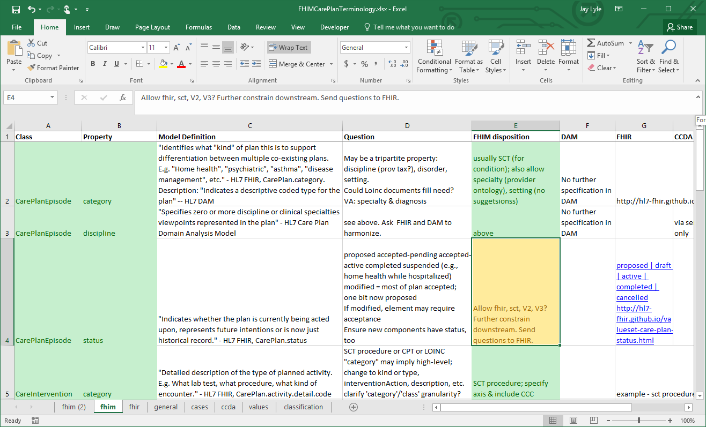
Current Process: Discussions on weekly call

Slide 6
Prospective Vocabulary Modeling Process
Use VSAC Collaboration tool
  More open
  Authoring more tightly coupled with publication (1 & 2)
Process
  Create draft in VSAC
  Publish draft to VSAC Collaboration
  Use Collaboration features to solicit input from team
  Finalize version in Collaboration
  Publish final version in VSAC

Slide 7
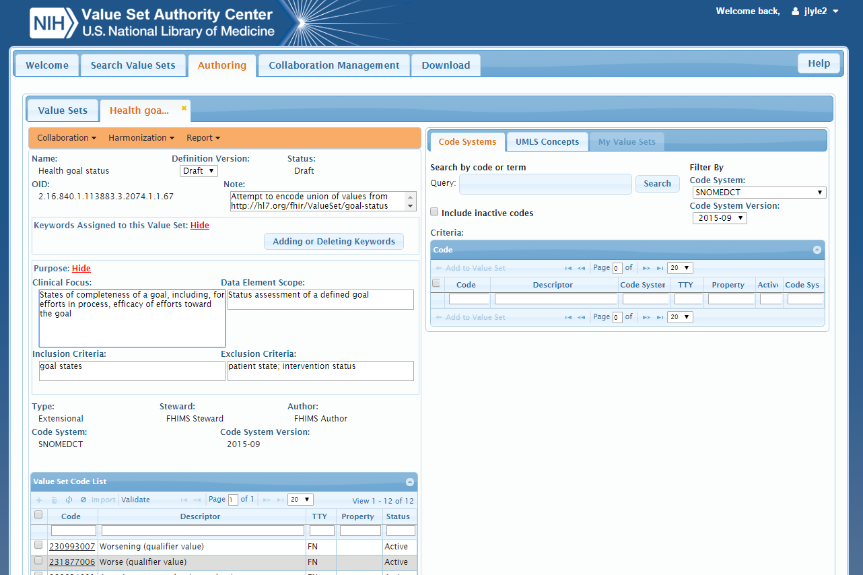
VSAC Authoring Environment

Slide 8
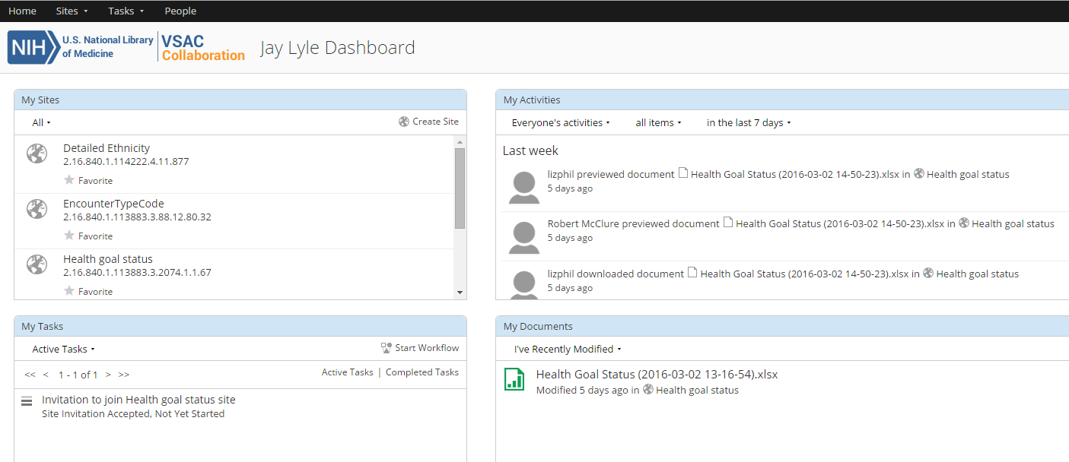
VSAC Collaboration Environment

Slide 9
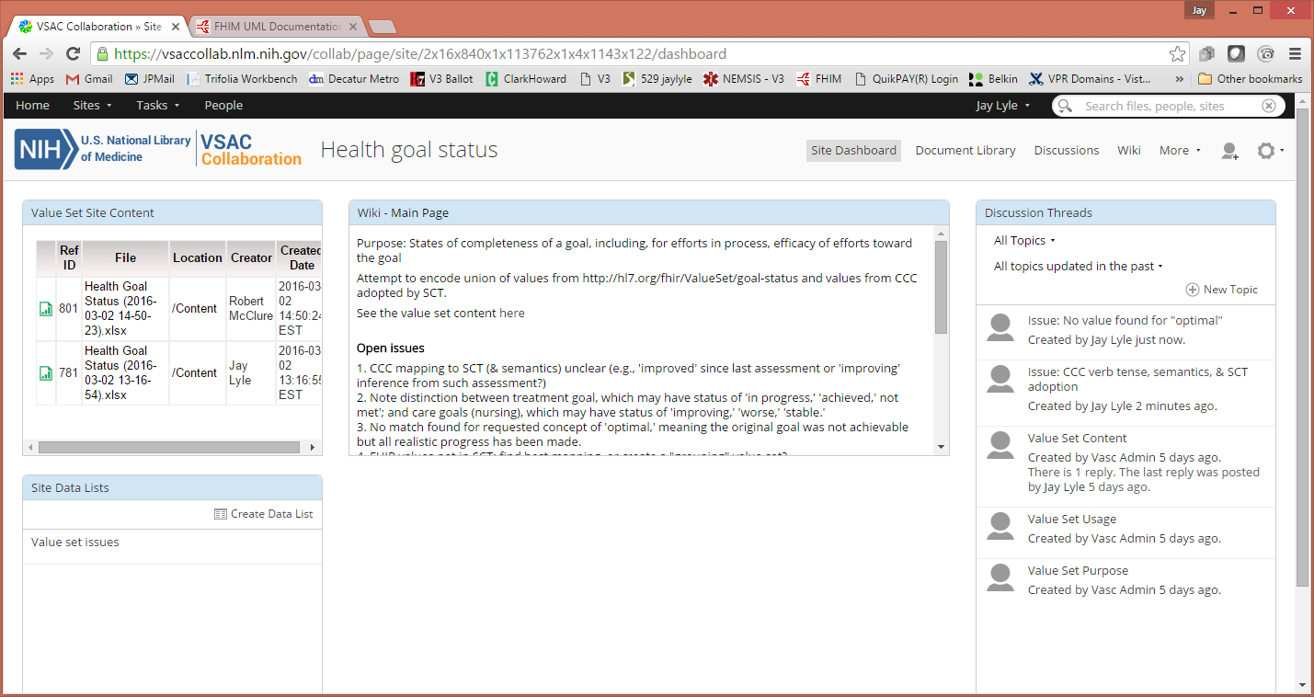
VSAC Collaboration: Value Set Site

Slide 10
VSAC Collaboration: Value Set Site
Issue management options

Slide 11
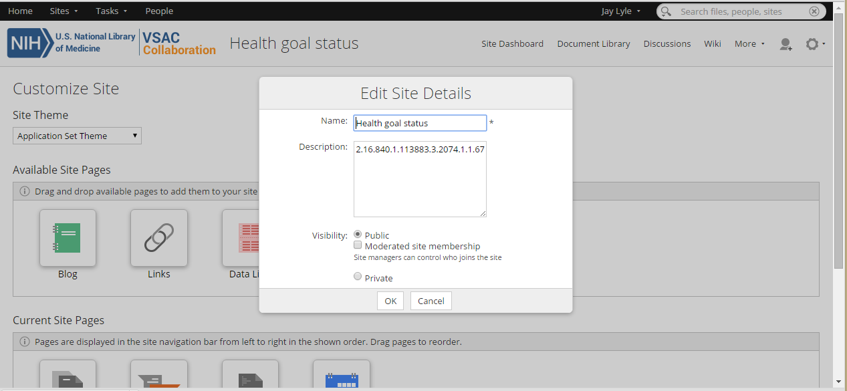
Public access to Collaboration
(for UMLS licensees)

